Slide 1
Illumination Model
Dr. Sk. Mohammad Masudul Ahsan
&
S. M. Taslim Uddin Raju
Edited by:
Md Nazirul Hasan Shawon
Lecturer, CSE, KUET

Slide 2
What You’ll See Today
Lighting Principles
Illumination Model
Ambient
Diffuse
Specular
Shading

Slide 3
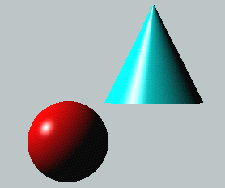

Lighting Principles
Lighting simulates how objects reflect light
material composition of object
light’s color and position
global lighting parameters
ambient light
two sided lighting
available in both color index and RGBA mode

Slide 4

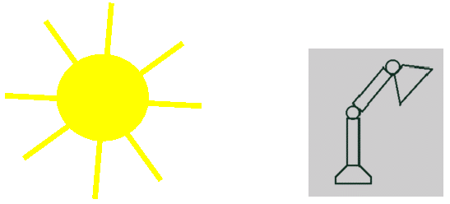
Light Source Model
Simple Mathematical Models:
Point light
Directional light
Spot light

Slide 5
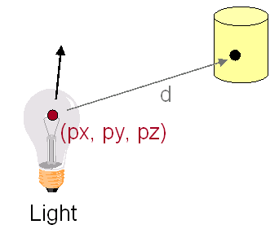
Point Light Source
Models Omni-Directional Point Source (E.g., Bulb)
Intensity (I₀)
Position (px, py, pz)
Factors (k_{c}, k_{l}, k_{q}) for attenuation with distance (d)

Slide 6
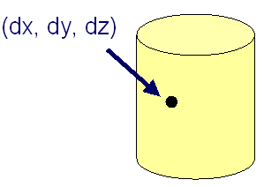
Directional Light Source
Models Point Light Source at Infinity (E.g., Sun)
Intensity (I₀)
Direction (dx,dy,dz)
No attenuation
with distance

Slide 7
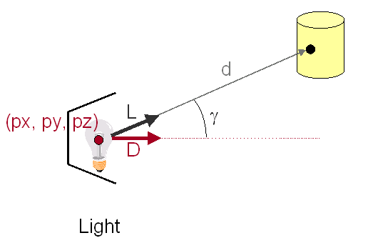
Spot Light Source
Models Point Light Source with Direction (E.g., Luxo)
Intensity (I₀)
Position (px, py, pz)
Direction (dx, dy, dz)
Attenuation

Slide 8
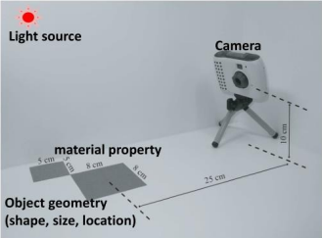
Illumination Model
How to compute color to represent a scene
As in taking a photo in real life:
Camera
Lighting
Object
Geometry
Material
Illumination model:
Combine all to produce a color Light source

Slide 9
Illumination Model
An object is illuminated from ambient light and from interrelated light source.
The important components are:
Ambient Light
Diffuse Refection
Specular Reflection
Global Illumination = Ambient Light + Diffuse Light + Specular Light + Emissive Light

Slide 10
Ambient Light
Also called background light
General level of illumination that does not come directly from a light source
Consists of light that has been reflected and re-reflected so many times
When ambient light strikes a surface, it's scattered equally in all directions.
Its direction is impossible to determine

Slide 11
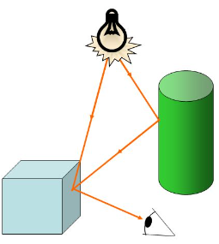

Ambient Light
Light from environment
Light reflected or scattered from other objects
Coming uniformly from all directions and then reflected equally to all directions.
$I_{A}=K_{A} I_{AL}$

Slide 12
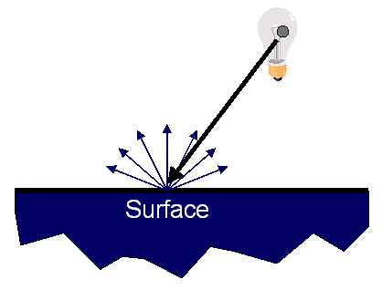
Diffuse Reflection
Light that comes from one direction
Light scattered with equal intensity in all directions (ideal diffuse reflection)

Slide 13
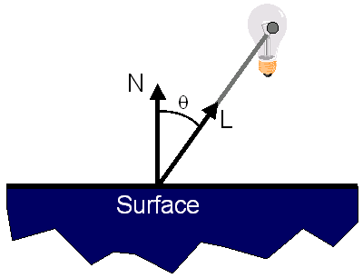
Diffuse Reflection
How Much Light is Reflected?
Depends on angle of incident light

Slide 14
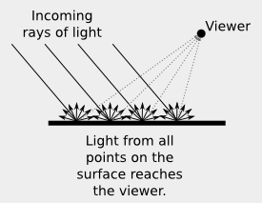
Diffuse Reflection
Light from a point is independent on viewing direction (equally bright in all directions)
Once it hits a surface, however, it's scattered equally in all directions, so it appears equally bright, no matter where the eye is located.

Slide 15
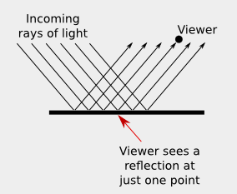
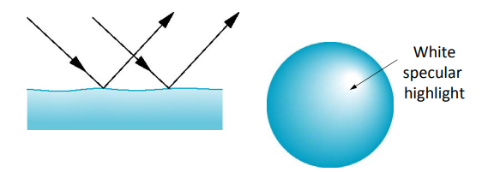
Specular Reflection
Light comes from a particular direction, and it tends to bounce off the surface in a preferred direction.
Depends on angle of incident light and angle to viewer
Intensity depends on where the viewer is!

Slide 16
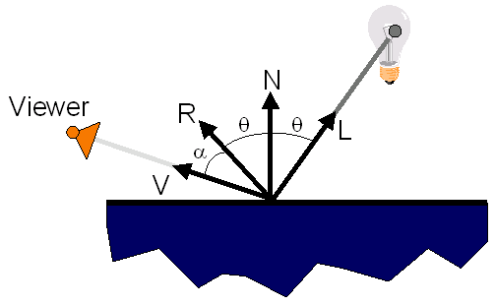
Specular Reflection
How Much Light is Reflected?
Depends on angle of incident light and angle to viewer

Slide 17
Surface Illumination Calculation
Single Light Source:
Light comes from a particular direction, and it tends to bounce off the surface in a preferred direction.

Slide 18
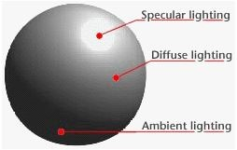
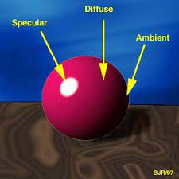
At a glance

Slide 19
Gouraud Surface Rendering (cont…)
N₂
The average unit normal vector at V is given as:
or more generally:
N_{V}
N₁
N₃
N₄
V

Slide 20
Gouraud Surface Rendering (cont…)
Illumination values are linearly interpolated across each scan-line
y
3
1
Scan-line
4
p
5
2
x

Slide 21
Gouraud Shading
An Example
Vertex 1
I = 0.2
0.35
0.50
0.65
Vertex 2
I =0.8
0.3
0.85
0.4
0.9
0.5
0.95
I = 0.6
Vertex 4
I = 1.0
Vertex 3

Slide 22
Phong Surface Rendering (cont…)
N₃
N₁
N₄
N_{p}
Scan line
p
N₅
N₂

Slide 23
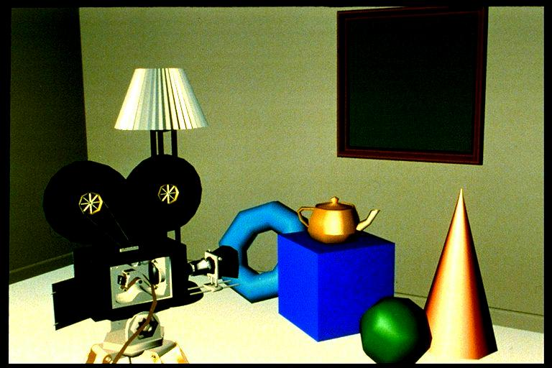
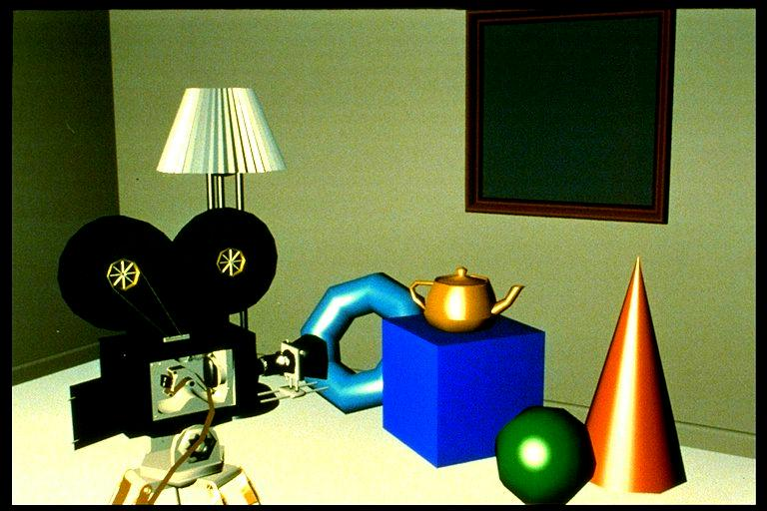
Gouraud Vs Phong Surface Rendering
Gouraud Surface Rendering
Phong Surface Rendering

Slide 24
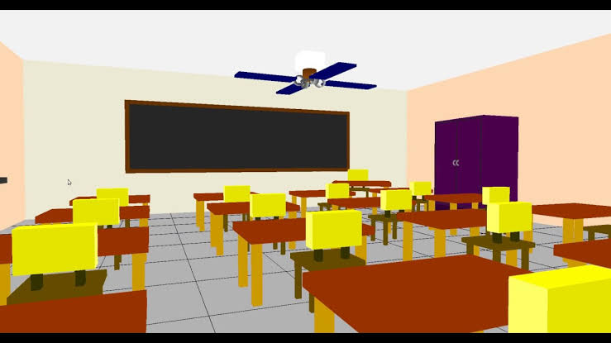
Assignment (A1)
Implement lighting on your previous assignment.
Your scene should have point light, directional light spot light and emissive light.
Use keys 1 to turn on and off directional light, 2 to turn on and off point light, 3 to turn on and off spot light respectively.
Use keys 4 to turn on and off ambient light, 5 to turn on and off diffuse light, 6 to turn on and off specular light of the light sources.

Slide 25
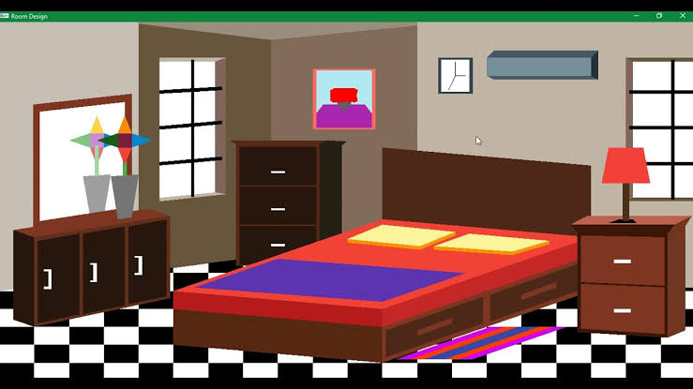
Assignment (B1)
Implement lighting on your previous assignment.
Your scene should have point light, directional light spot light and emissive light.
Use keys 1 to turn on and off directional light, 2 to turn on and off point light, 3 to turn on and off spot light respectively.
Use keys 4 to turn on and off ambient light, 5 to turn on and off diffuse light, 6 to turn on and off specular light of the light sources.

Slide 26
REFERENCES
Anonymously Collected

